Slide 1
Effect of population with optimal configuration for Disease spread

Slide 2
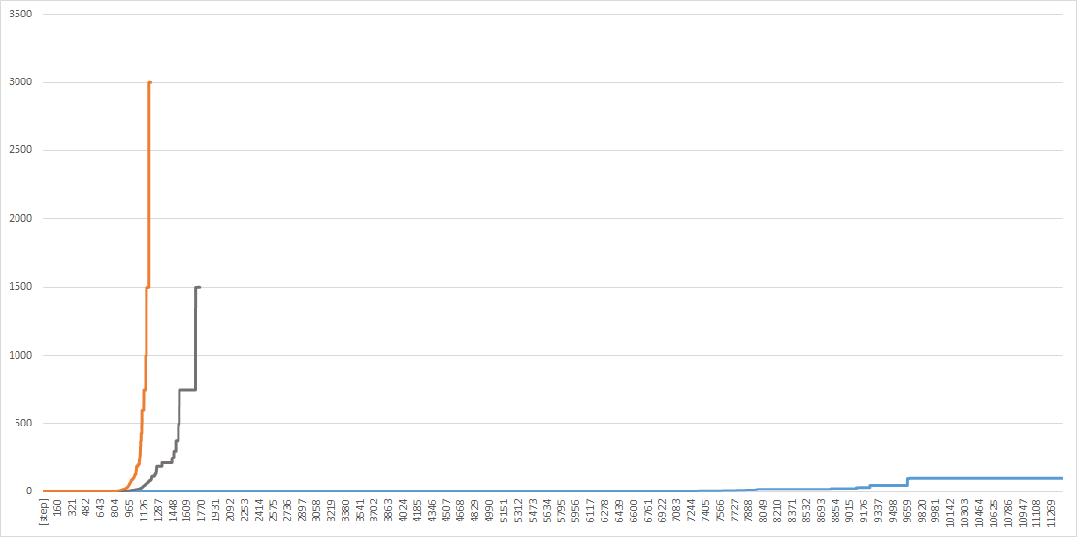
Effect of population with pessimal configuration for Disease spread

